Slide 1

Capstone Project

Slide 2



Personal BACKGROUND
(Name, Past Experience, Qualification, Career Summary)
Name : Nandhini Venkatesan
Past Experience : Fresher
Qualification : BE – Computer Science Engineering
Career Summary :
I am at the beginning of my professional journey at Ascendion as a Backend Developer, equipped with a solid foundation in backend technologies and software development principles. With a strong educational background in computer science, I have developed a keen interest in creating robust, scalable, and efficient backend systems.
www.collaberadigital.com

Slide 3


Key Takeaways/Learnings from the Program (HTD)
Key Learnings
Core & Advanced Java: Utilized Java for implementing core functionalities and advanced features.
Spring Framework: Applied Spring Boot for building microservices and Spring Data JPA for ORM.
AWS Integration: Deployed services on AWS EC2 and managed service discovery with Eureka.
Testing: Conducted API testing with Postman and performed code quality checks using SonarLint.Additionally with help of Junit testcase are done.
Feign Client-Inter-Service Communication: Utilized Feign Client for declarative HTTP clients, simplifying inter-service communication within the microservices architecture.

Slide 4

Problem Statement of the Capstone Project
Overview:
The aviation industry requires a robust and efficient system to manage and oversee various aspects of air transport operations, including airport details, plane management, and passenger bookings. Administrators need a centralized platform to perform these tasks seamlessly, ensuring smooth operations and accurate data management.
Challenges:
Authentication & Security: Secure login, password policies, and account lockout.
Airport Management: Viewing, managing, and adding airports with autogenerated codes.
Plane Management: Managing planes, including autogenerated registration numbers and image storage.
Booking Management: Handling bookings with autogenerated IDs, and validation of dates and times.
Administrator Registration: New admin registration with validations for email, phone number, and password.

Slide 5
Problem Statement of the Capstone Project
Objective
Develop an advanced Air Transport System (ATS) using microservices with Spring Boot and AWS to improve how airports, planes, and bookings are managed, focusing on security, scalability, and ease of use.
Key Features
Integrated Platform: Seamlessly manage all aspects of airports, planes, and bookings from a single, unified system.
Automation & Precision: Implement automated ID generation to minimize manual errors and streamline processes.
Robust Security: Incorporate advanced security protocols to ensure the protection of sensitive data across the system.
Scalable Infrastructure: Leverage microservices and AWS to create a highly flexible and scalable architecture, adaptable to future growth.
Intuitive User Experience: Design a user-friendly interface that promotes efficient and effortless management of operations.

Slide 6
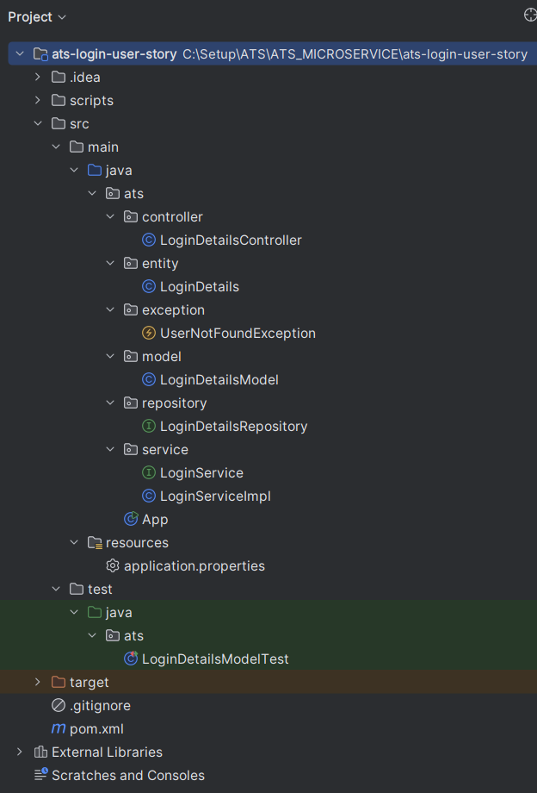
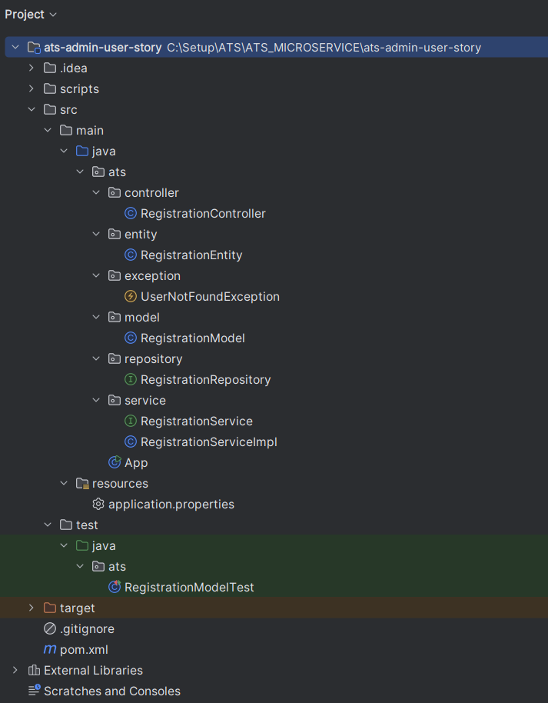
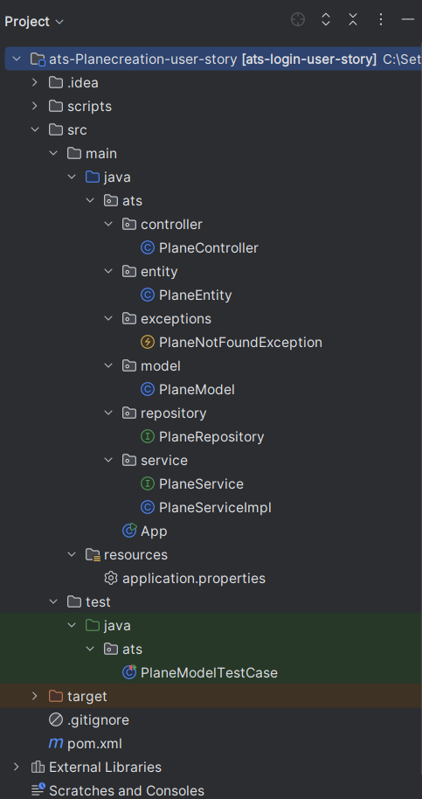
Structure of Login, Admin, Plane Microservice

Slide 7
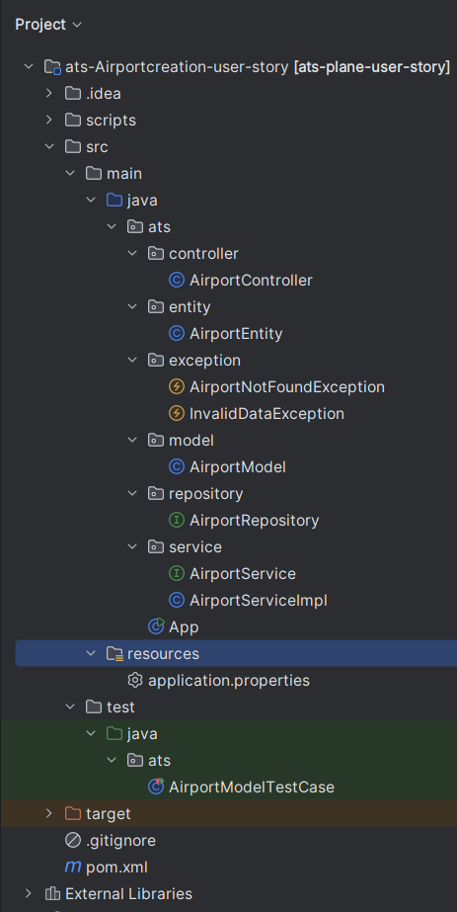
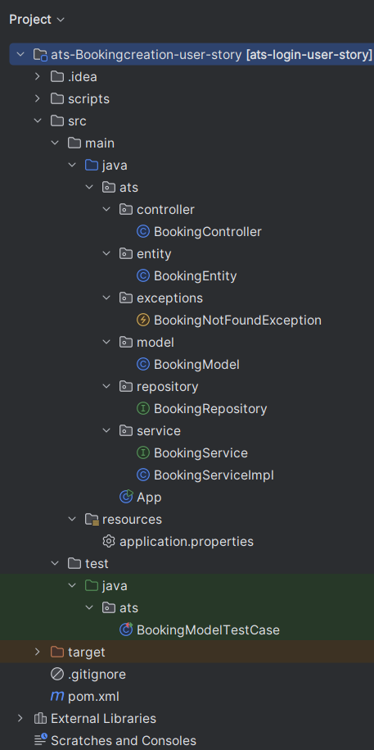
Structure of Airport, Booking Microservice

Slide 8
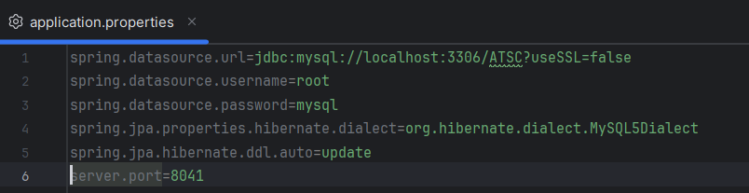
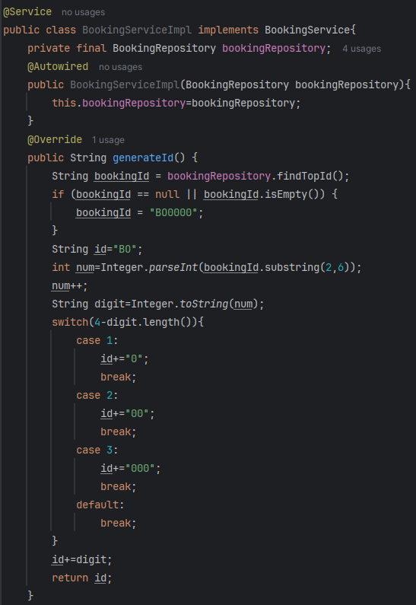
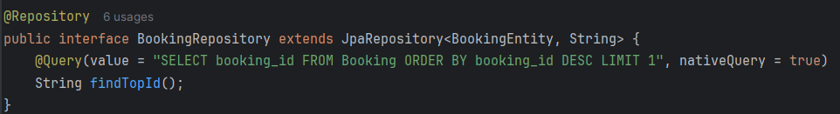
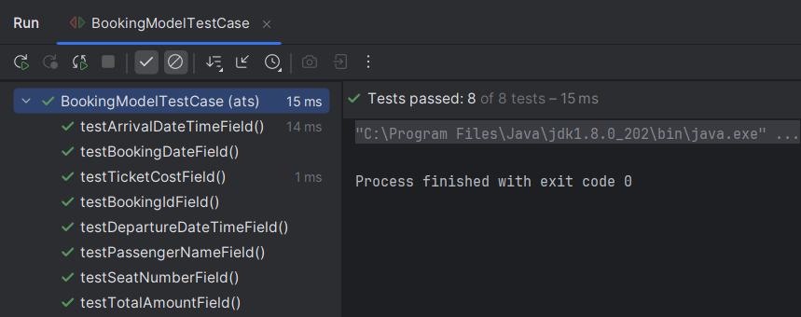
Booking Microservice – Repository, Service, Junit, application.properties

Slide 9
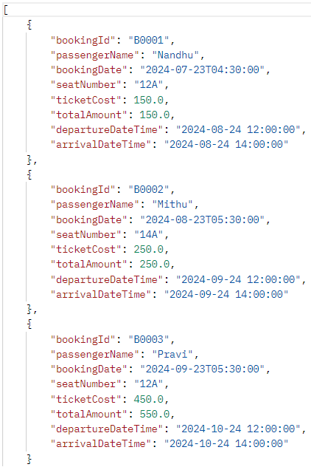
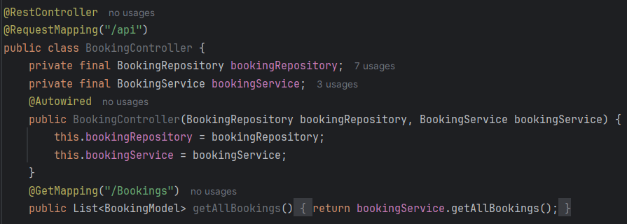
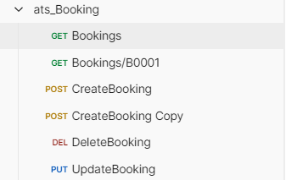
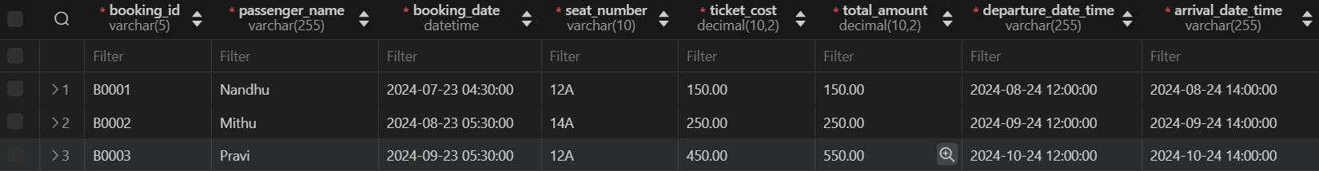
Booking Microservice – Controller, Database, Postman

Slide 10
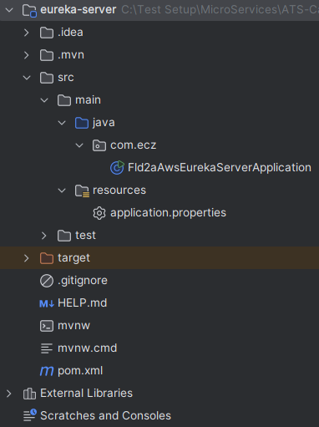
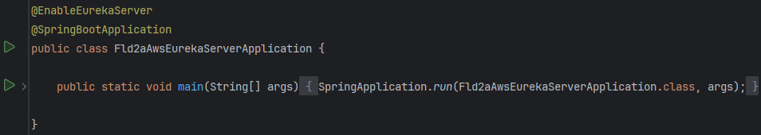
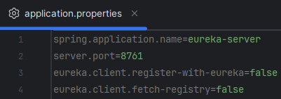

Eureka Server – application.properties

Slide 11
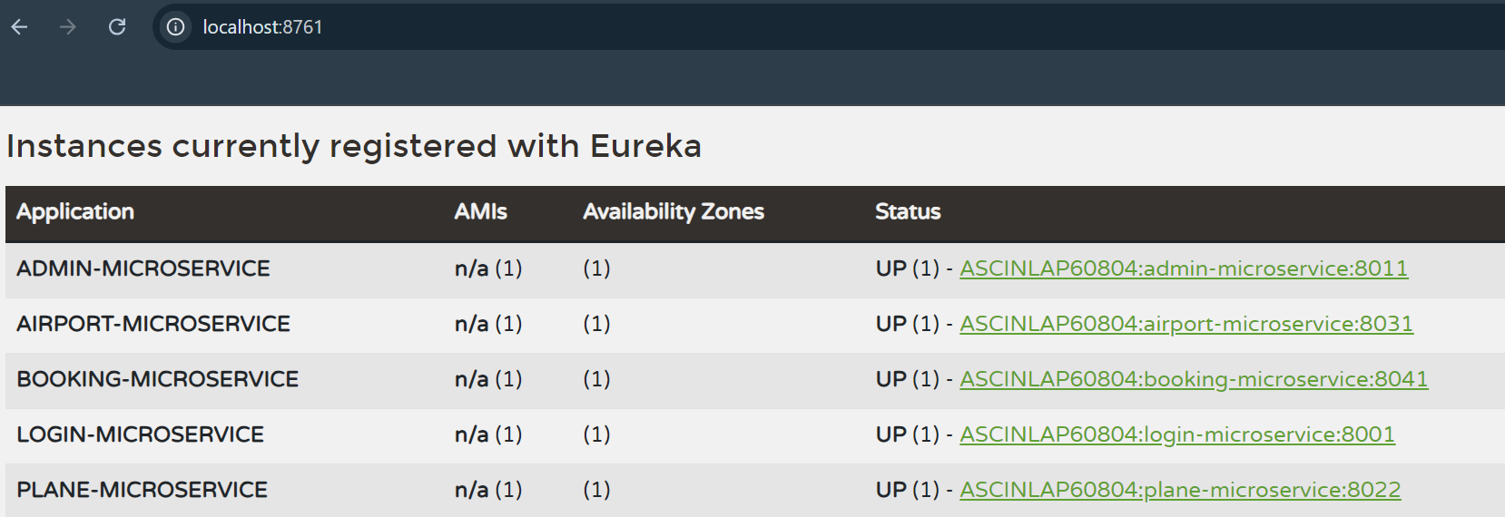
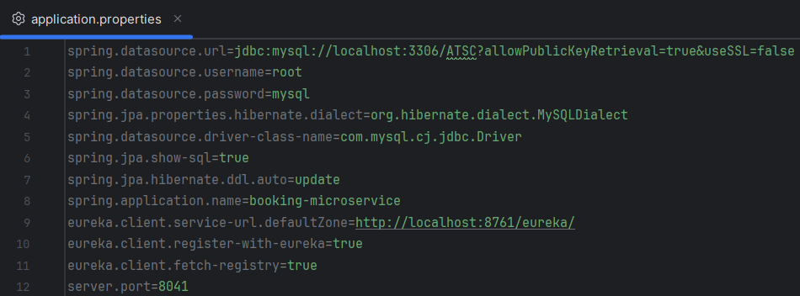
Eureka Server – Instance of All Microservices

Slide 12
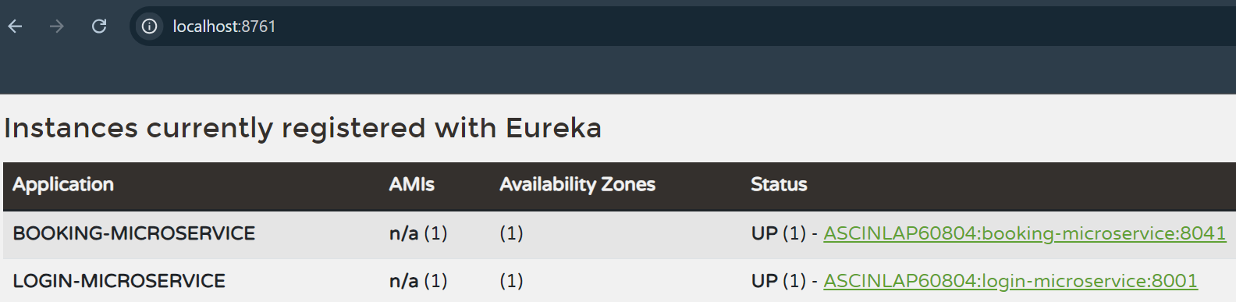
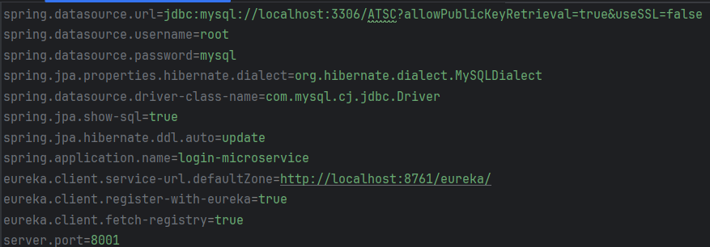
Feign Client – Instance Of Login and Booking Microservice in Eureka Server

Slide 13
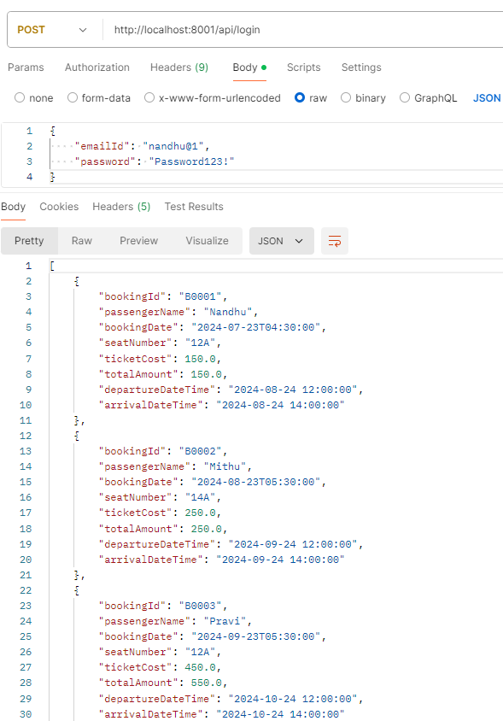
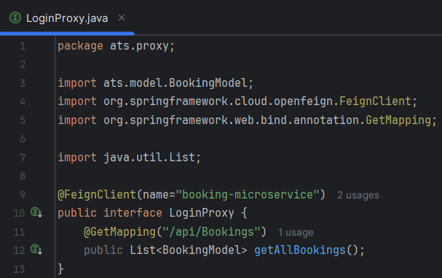
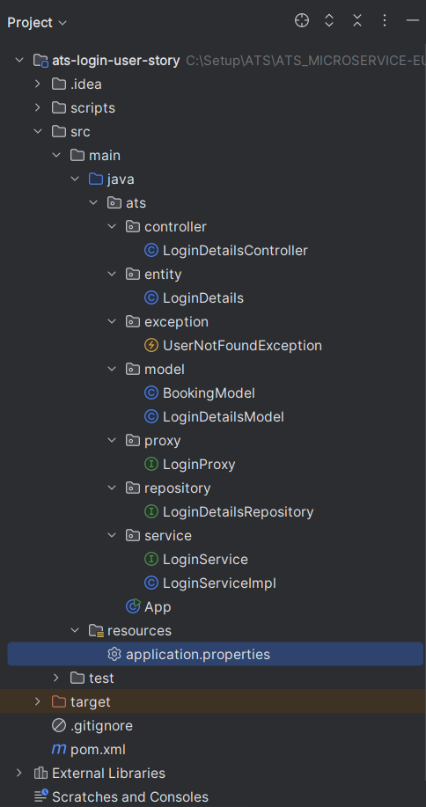
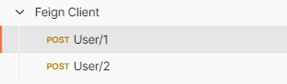
Feign Client – Connecting Login and Booking Microservice
When Login Successful, display all booking details to user who is login.

Slide 14
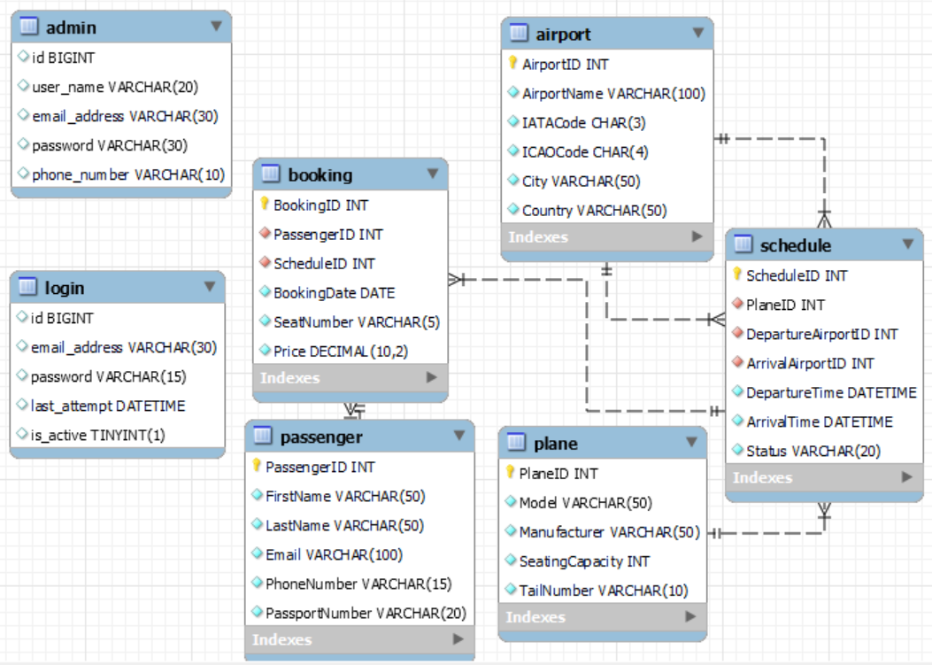
Entity-Relationship Diagram

Slide 15
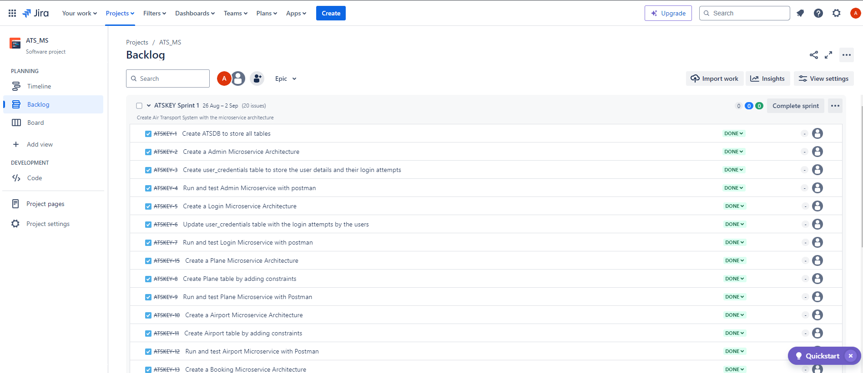
JIRA – Air Transport System - Sprint

Slide 16
Conclusion
The Air Transport System (ATS) project aims to address the key challenges faced by the aviation industry by providing a comprehensive, scalable, and secure platform for managing airport operations, aircraft details, and passenger bookings. By leveraging a microservices architecture with Spring Boot and AWS, ATS ensures efficient data management, robust security, seamless integration, and enhanced scalability.
This solution not only streamlines administrative processes but also minimizes errors and enhances the overall user experience. Implementing ATS will lead to improved operational efficiency, increased security, and higher customer satisfaction, positioning the system as a vital tool for modernizing air transport management.

Slide 17
Thank You

